Slide 1
Trading Price Predictions with Strategy Selector
Catherine Ding, Hyun Bin Shin, Venkata Aditya Reddy Choppa, Amir Nizam

Slide 2
Motivation & Summary Slide
We are using machine learning models to predict the stock (traded securities, including FX, commodities) prices as well as trading signals from certain traditional strategy to compare the models’ final returning results and select the best models for certain stocks (traded securities).
Hypothesis
we assume the trade can be always executed by the closing price without price spread effects with 0 trading commission cost to simplify the results.
For the pricing prediction, we assume that the stock prices can be predicted by machine learning models with its own historical price trend, as well as the external economic conditions data.
The prophet model can be used to capture the seasonality trend of stock prices volatile activities across time.
Each stock (traded securities) has its own best fit prediction models for pricing and trading strategy in certain period.

Slide 3
Model Summary
Prophet model analysis to check the seasonality of the stocks volatile activities
Price prediction from Neuron Network and LSTM
Price prediction from linear and regression models
SVC and Decision Tree models for trading signals predictions with simple and double SMA crossover strategies
Combining prediction and trading models to exam the results.

Slide 4
Data Cleanup & Model Training
Exploration and cleanup process
Problems that arose with preparing the data or training the model without anticipation
Overall training process
Cloud data resources used
Training time required
Issues with training

Slide 5
Prophet Analysis for Seasonality Activities of the Stock
Assumption: Historical Prices are not best indication weather the prices will move in upward or downward direction.But, we may use techniques like trend analysis moving average and predict the trend.
Fb Prophet is an open-source forecasting tool developed by Facebook's Core Data Science team. It is designed to make time series forecasting accessible to non-experts by providing a simple and intuitive interface.

Slide 6
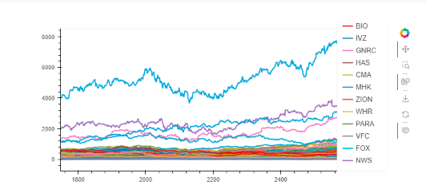
USING FB Prophet TO PREDICT THE PRICE TRENDS
Install Prophet and Import Libraries
Data Preparation : SP500 Stocks prices , Data preparation in suitable format for analysis the data should contain 2 columns one for the timestamp(ds) and for Y (observed values)
sp500_data.hvplot()

Slide 7
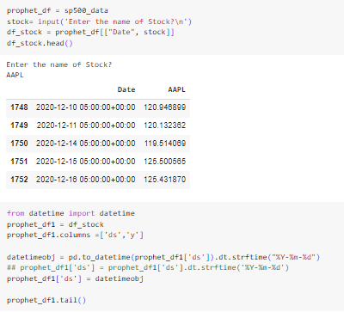
Selection of the Stock for Trend Analysis and Data Preparation

Slide 8
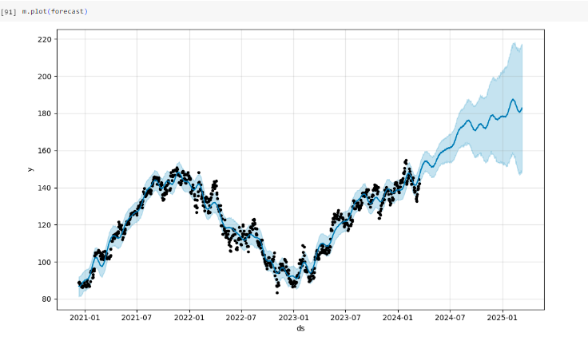

Slide 9
Neural Network and LSTM Price Predictor
1. Neural Network model
Features: M2, 10 year treasury, Shiller index, Fed fund effective rate, unemployment, disposable income, GDP, CPI, industrial production, commercial loans, gold, copper, US dollar index, crude oil, VIX, wheat, previous day’s S&P 500 price + engineered features from historic stock price
Target: Next day’s S&P 500 price
Target period: 2010-01-01 ~ 2018-12-31
Train, validation, test data: first 85% (training), subsequent 10% (validation), last 5% (test)
Scaling: Standard scaler (train data only)

Slide 10
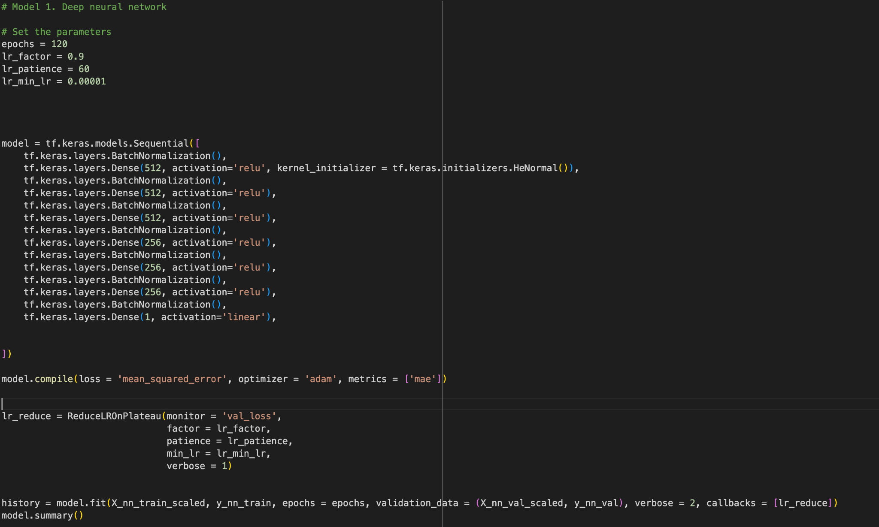
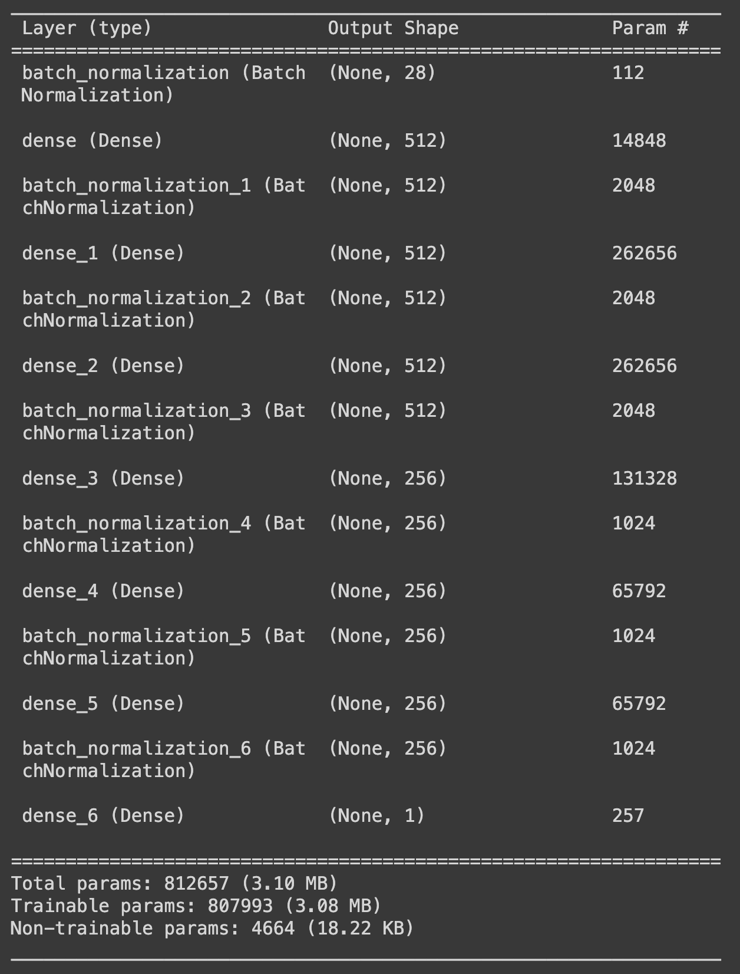
Neural Network and LSTM Price Predictor

Slide 11
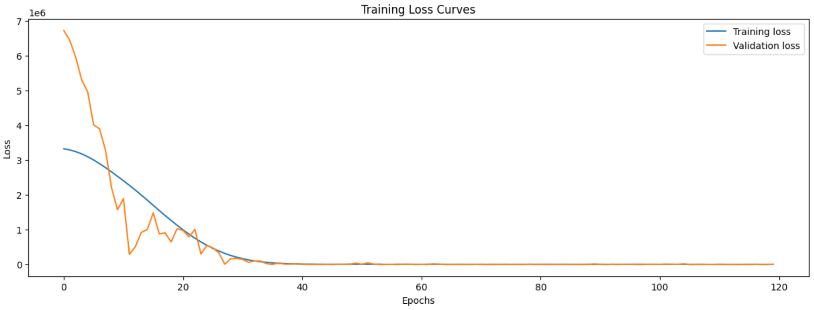
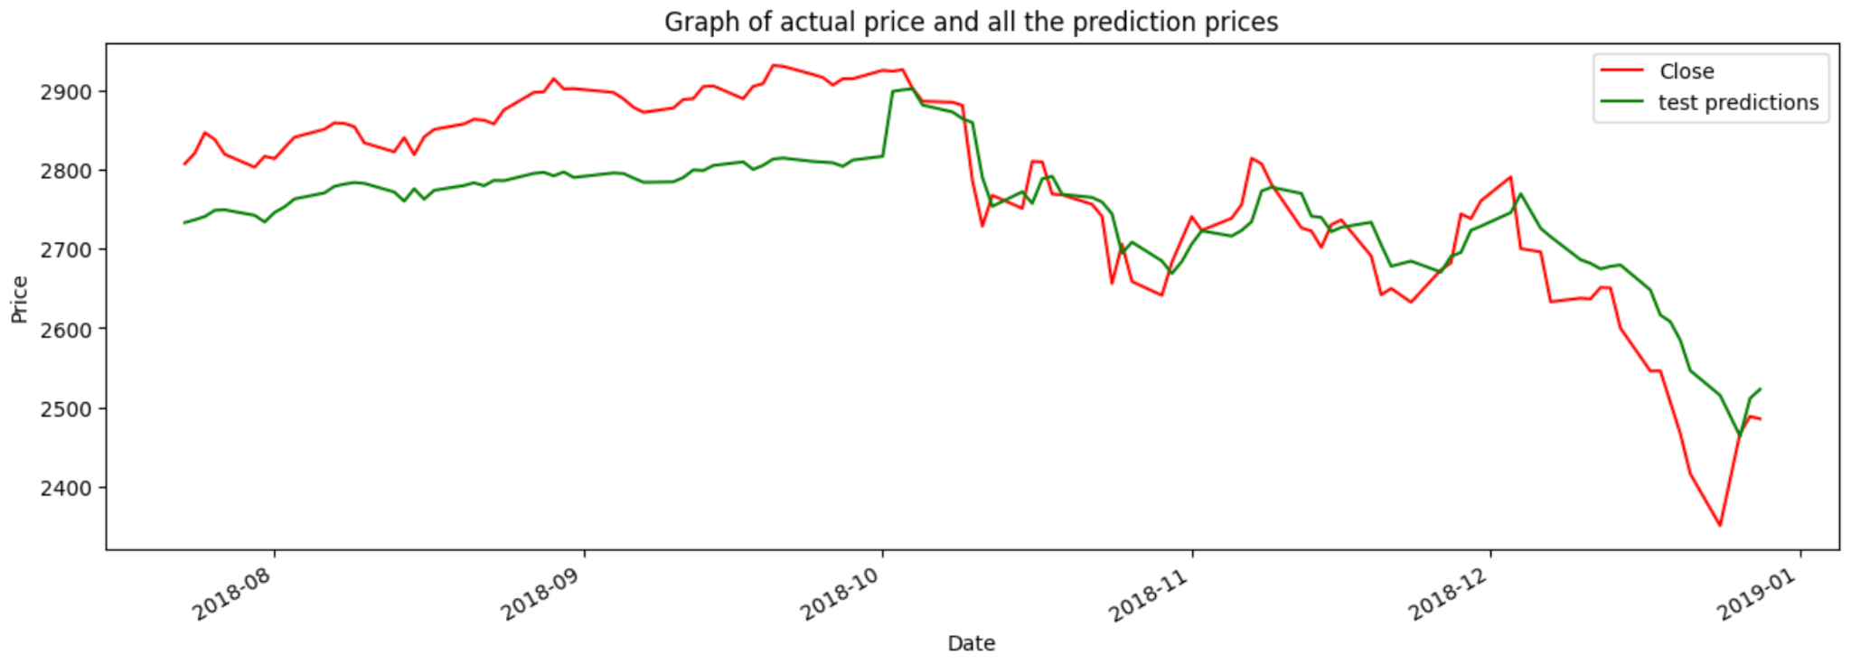
Neural Network and LSTM Price Predictor

Slide 12
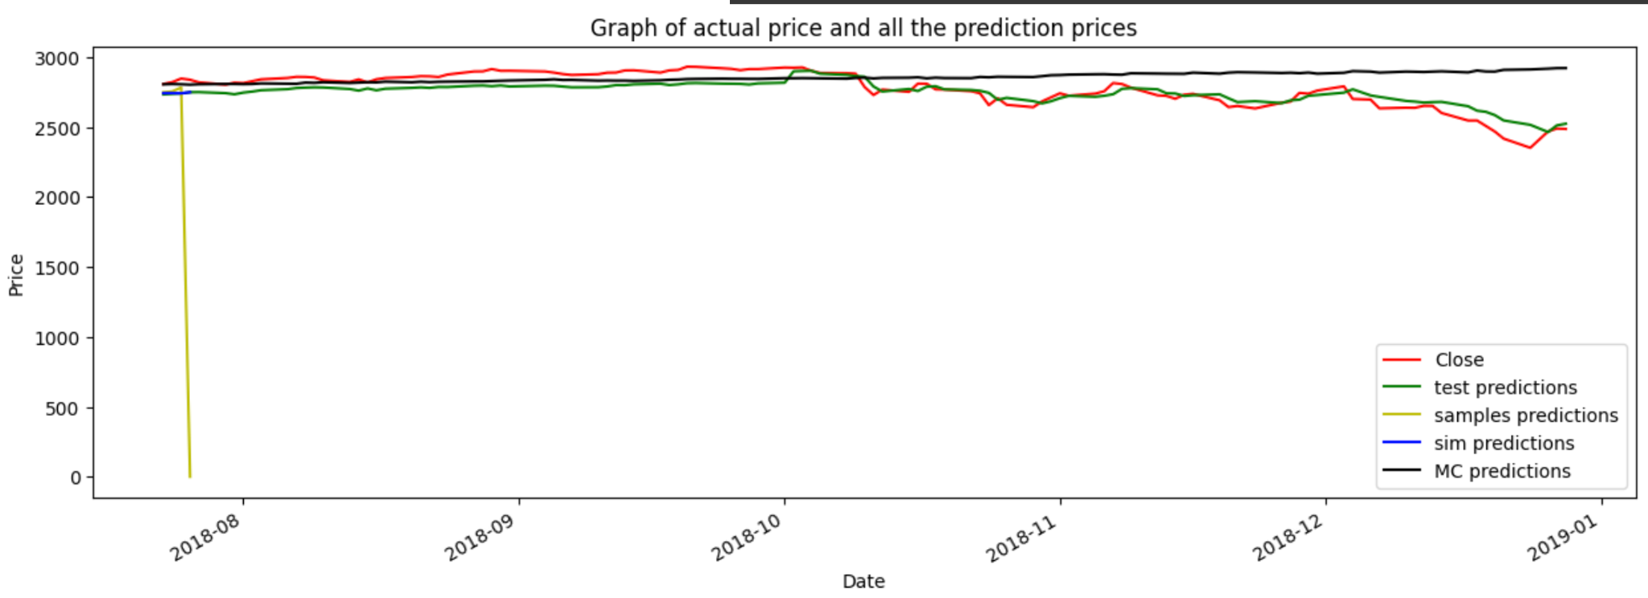
Neural Network and LSTM Price Predictor

Slide 13
Neural Network and LSTM Price Predictor
2. LSTM model using previous price only
Features: Previous consecutive 70 days of S&P 500 price
Target: Next day’s S&P 500 price
Target period: 2010-01-01 ~ 2018-12-31
Train, validation, test data: first 85% (training), subsequent 10% (validation), last 5% (test)
Scaling: Standard scaler

Slide 14
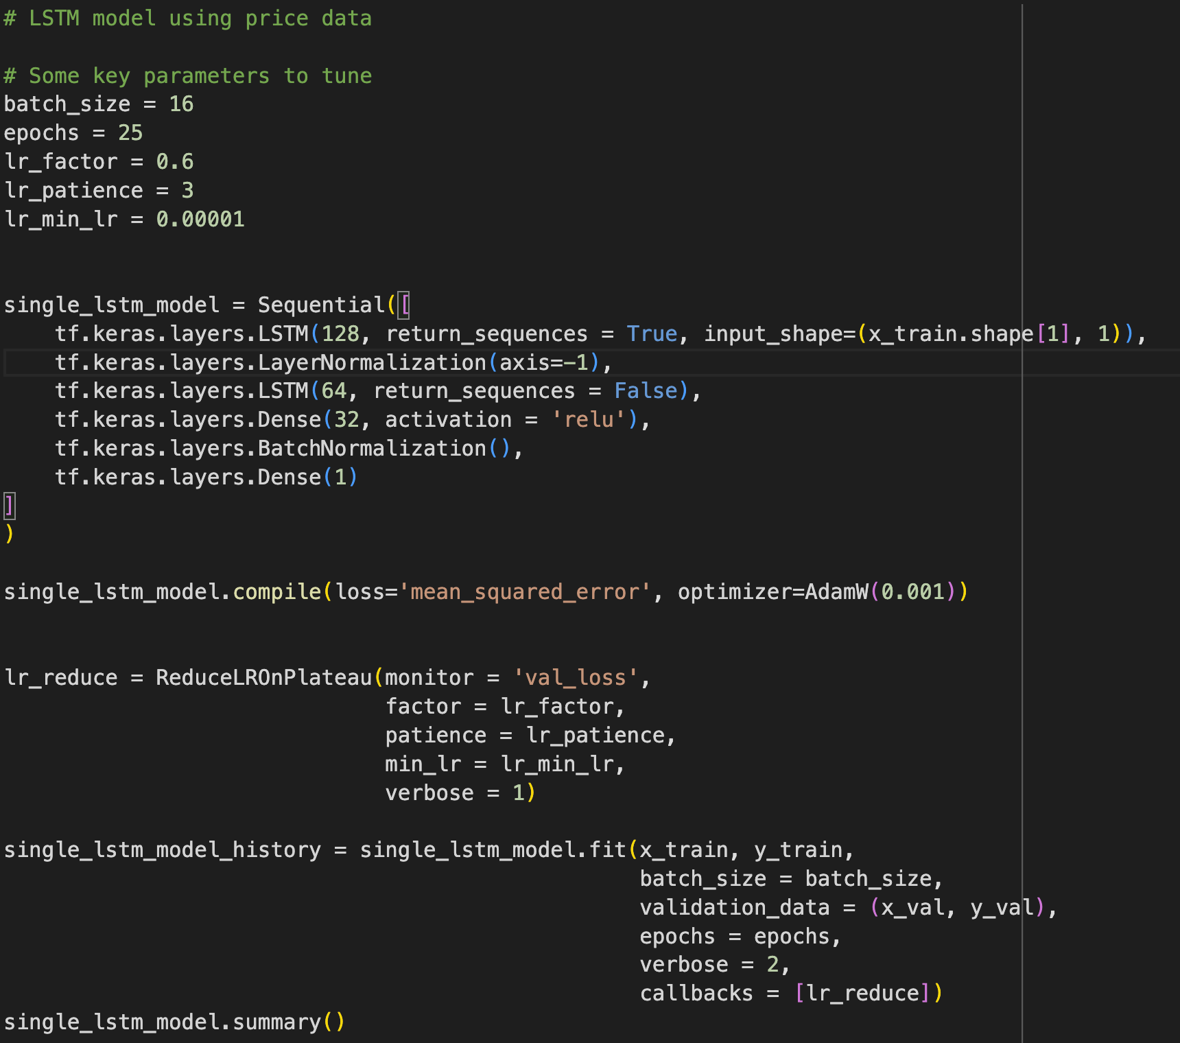
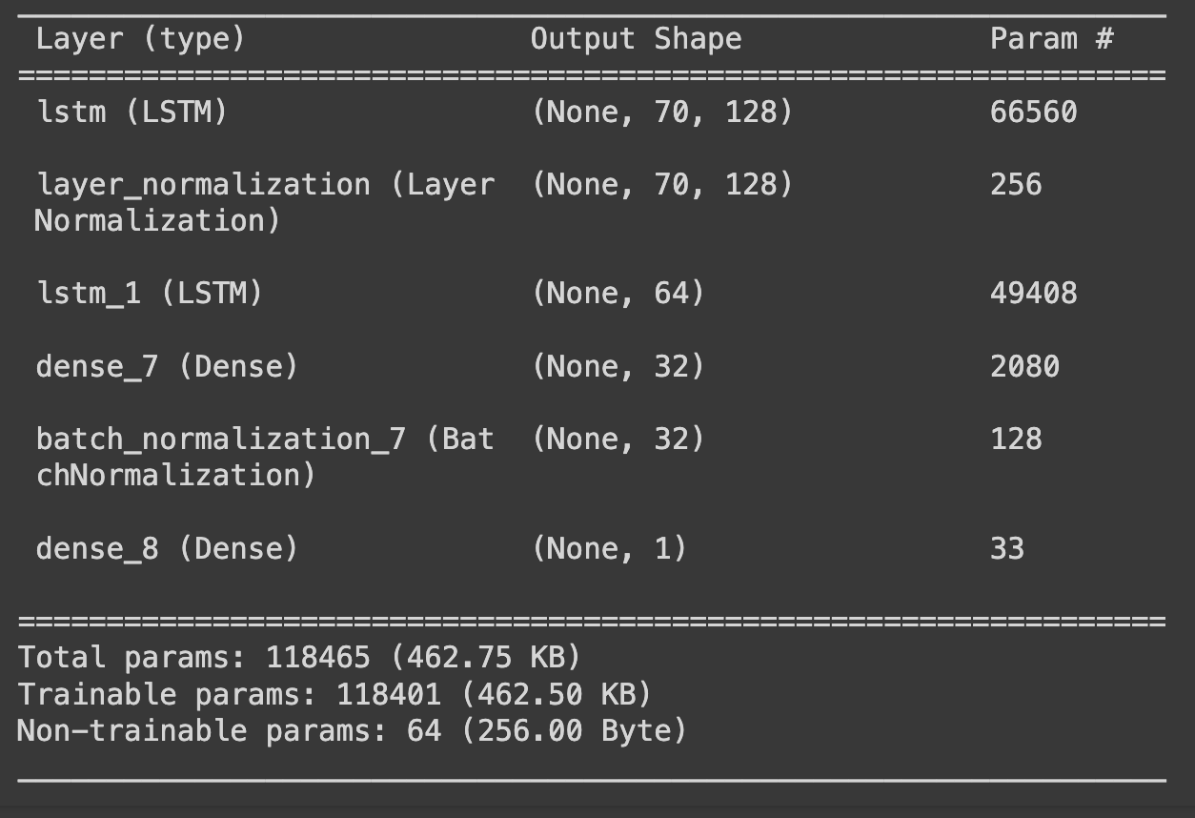
Neural Network and LSTM Price Predictor

Slide 15
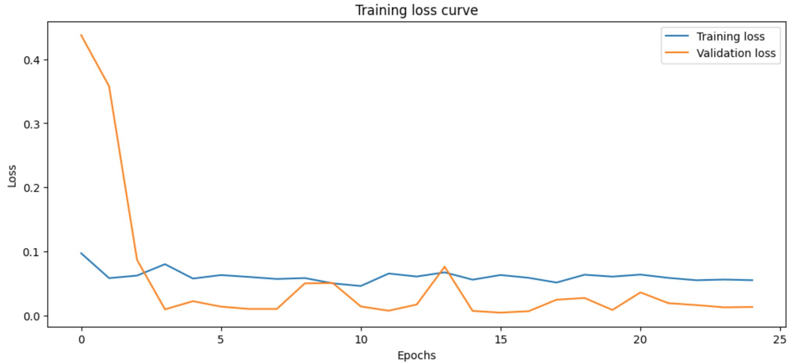
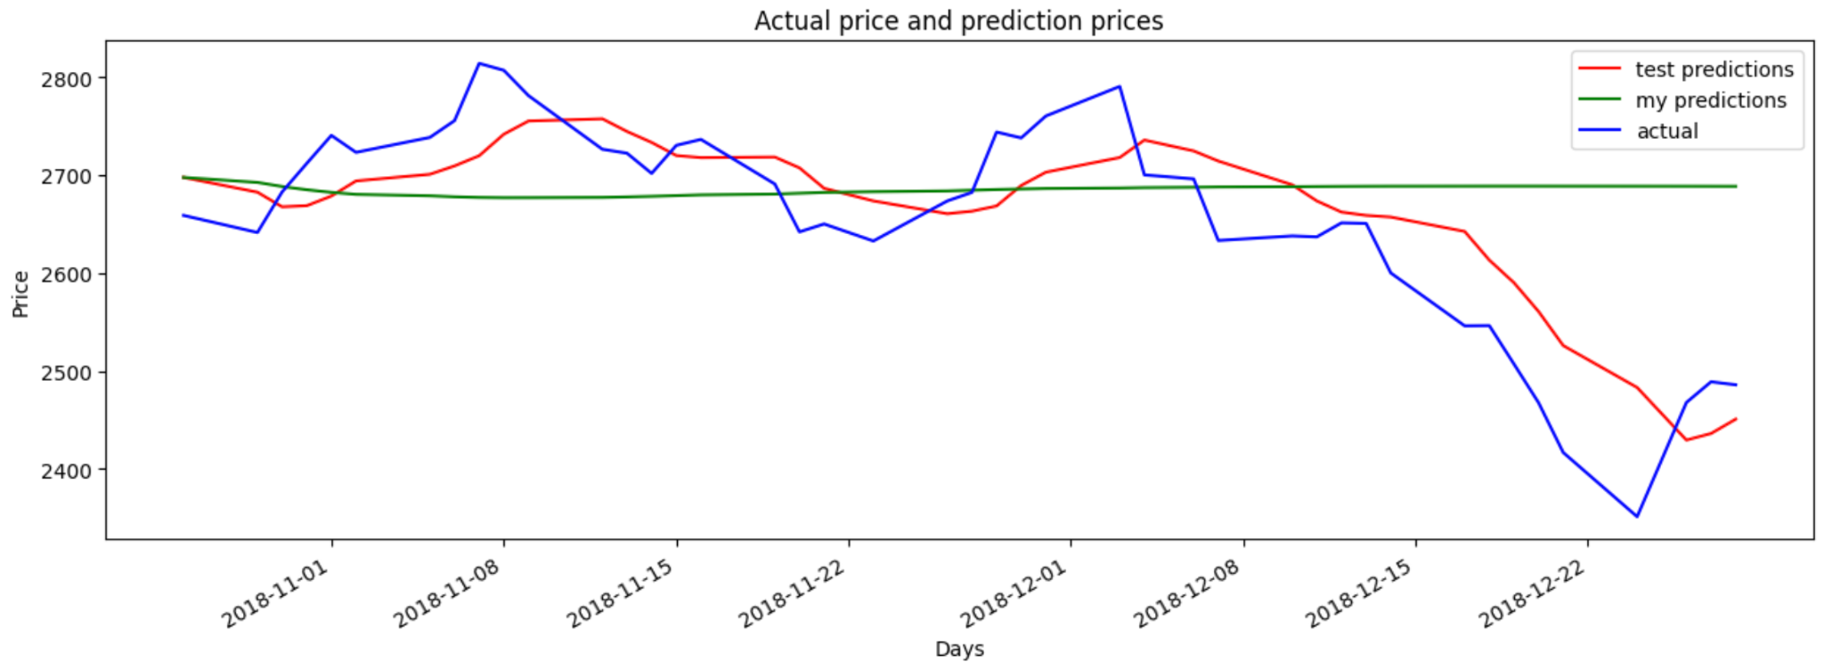
Neural Network and LSTM Price Predictor

Slide 16
Neural Network and LSTM Price Predictor
3. LSTM using previous price + other features
Features: M2, 10 year treasury, Shiller index, Fed fund effective rate, unemployment, disposable income, GDP, CPI, industrial production, commercial loans, gold, copper, US dollar index, crude oil, VIX, wheat, previous day’s S&P 500 price + engineered features from historic stock price (70 previous consecutive days)
Target: Next day’s S&P 500 price
Target period: 2010-01-01 ~ 2018-12-31
Train, validation, test data: first 95% (training), last 5% (test)
Scaling: Standard scaler (Train and test data, separately)

Slide 17
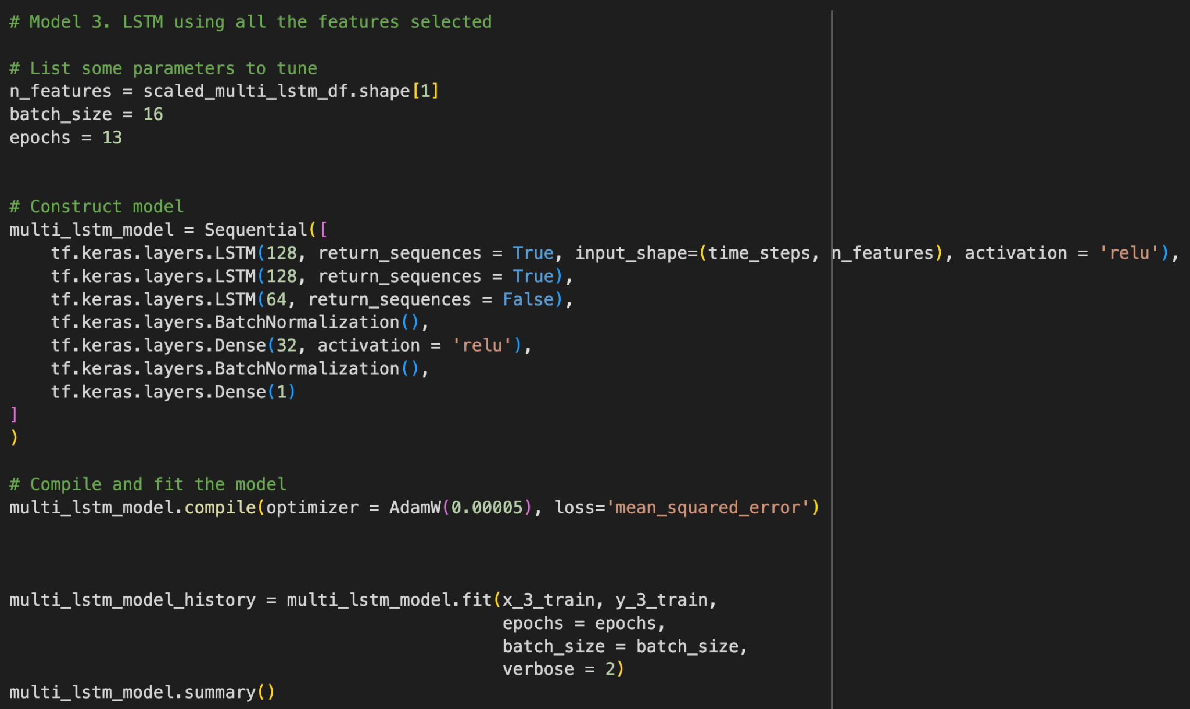
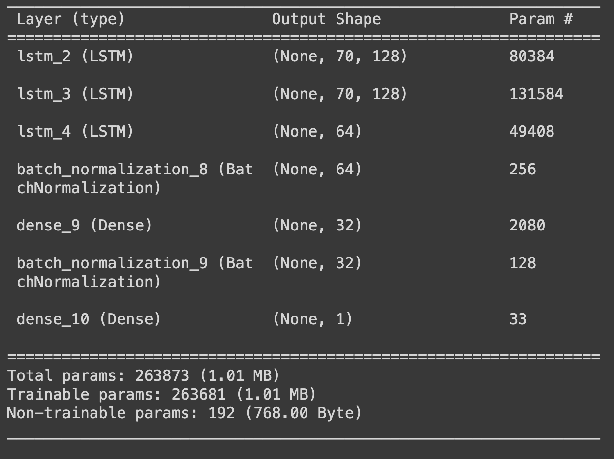
Neural Network and LSTM Price Predictor

Slide 18
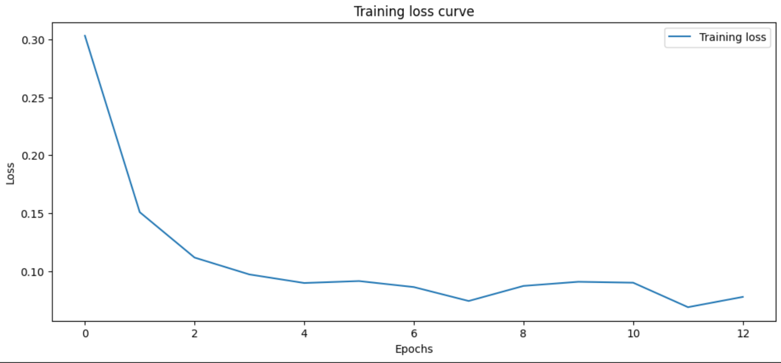
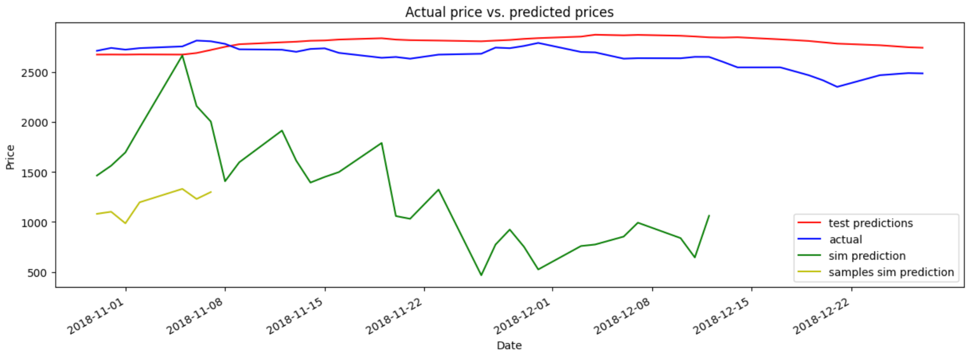
Neural Network and LSTM Price Predictor

Slide 19
Linear and Regression Price Predictor
The Output here is to predict close price of a selected stock from S&P 500 list.
First, using list of 5 Multi-linear Models:
Ridge(),
Lasso(),
MultiTaskElasticNet(),
LassoLars(),
BayesianRidge()
Second, using list of Regressors & Ensemble Models:
SVR
KNeighbourRegressor
DecisionTreeRegressor
MultiOutputRegressor with GradientBoostingRegressor

Slide 20
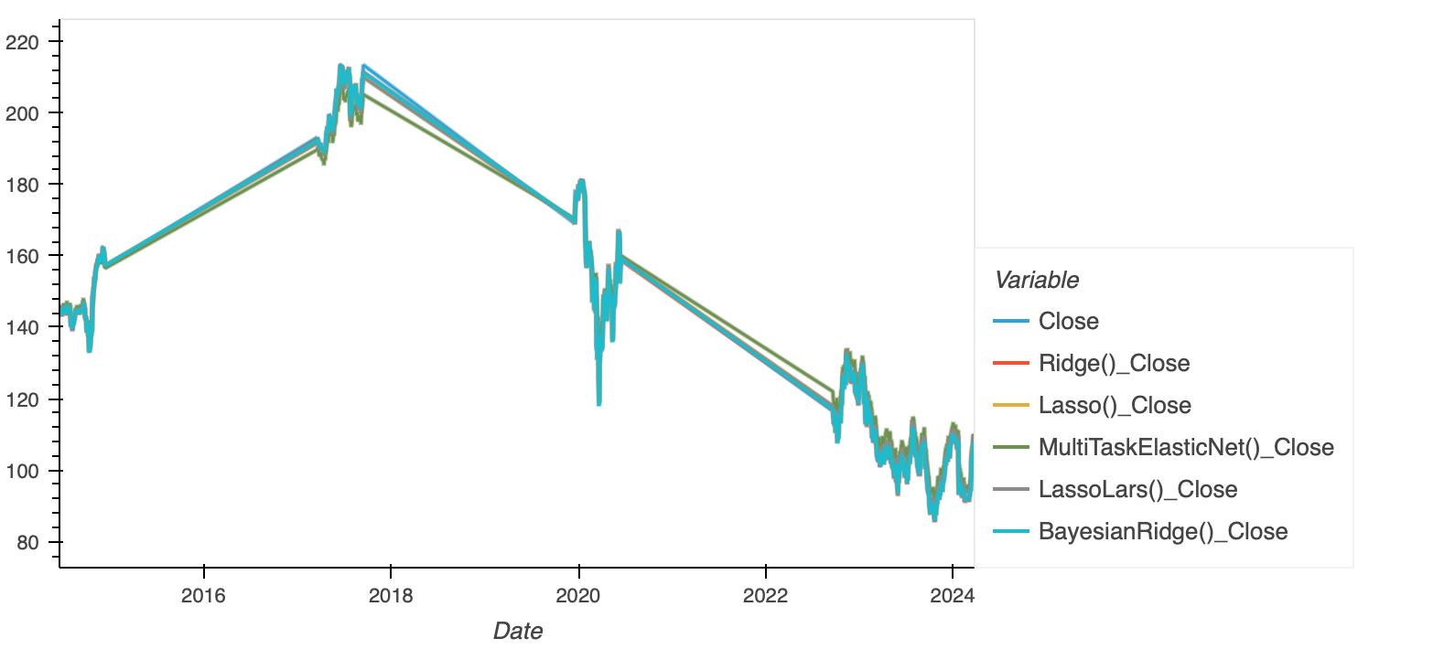
Custom Train_Test_Split
A customised train_test_Split is used
to train the selected models.
Training Data of 27months and
Testing Data of 6months alternatively
with latest 33months of testing data

Slide 21
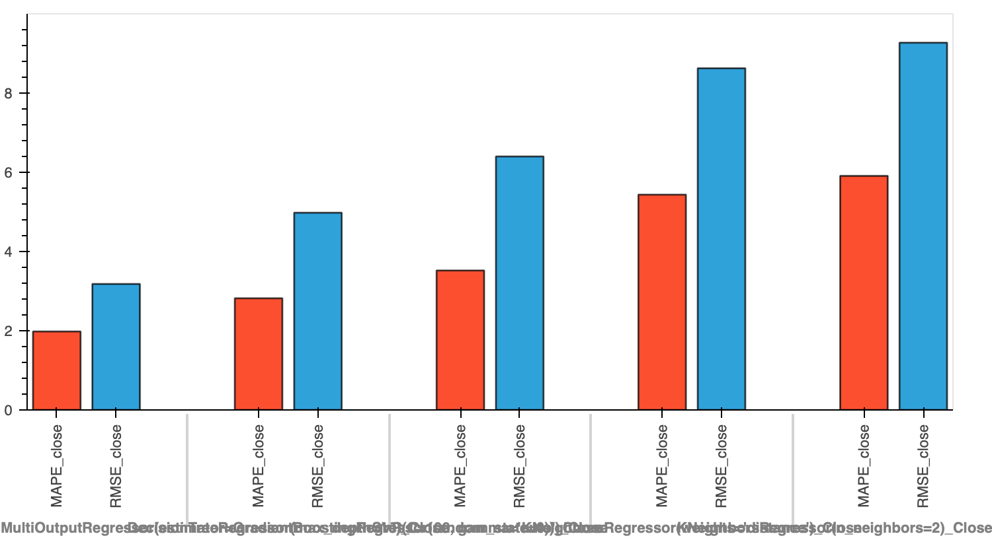
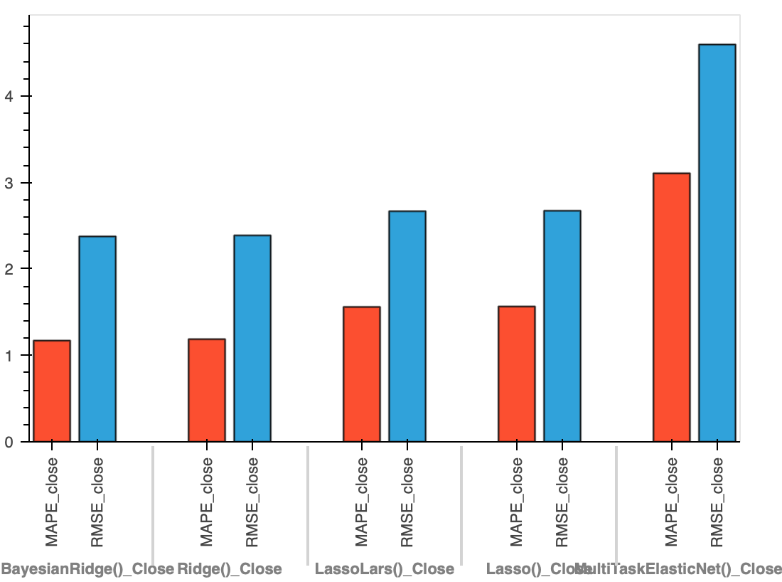
Model Evaluation
Models are compared based on RMSE & MAPE. The models with least MAPE were chosen from each set of models to predict future price. BayesianRidge and MultiOutput ensemble model performed comparatively better.

Slide 22
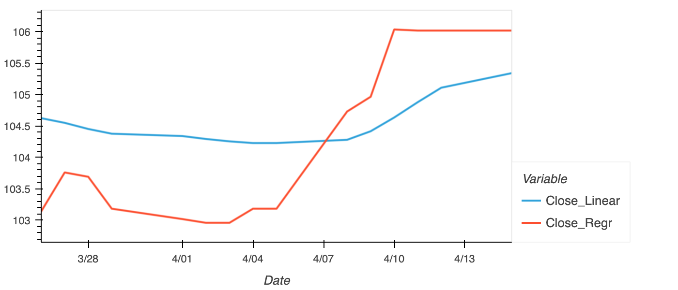
Model Prediction
Repetitive Prediction for Future Dates.Using the prediction data for current date,we predicted the price for next 14 days

Slide 23
SVC and Decision Tree Trading Signal Predictors
SVC and Decision Tree Classifier model
Features: SMA_Fast, SMA_Slow from historic stock price, M2, 10 year treasury, Shiller index, Fed fund effective rate, unemployment, disposable income, GDP, CPI, industrial production, private investment, commercial loans, gold, copper, US dollar index, crude oil, VIX, wheat
Target: future trading signals in short or long wrong
Sampling data period: 2014-01-01 ~ 2024-03-01
Train, test data: first 39 months (training), rest months (testing)
Trading strategies: Nearest day simple return strategy;
SMA crossover strategy: show window = 4, long window = 100
Scaling: Standard scaler

Slide 24
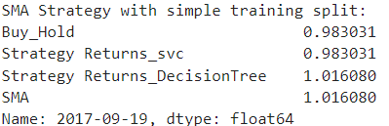
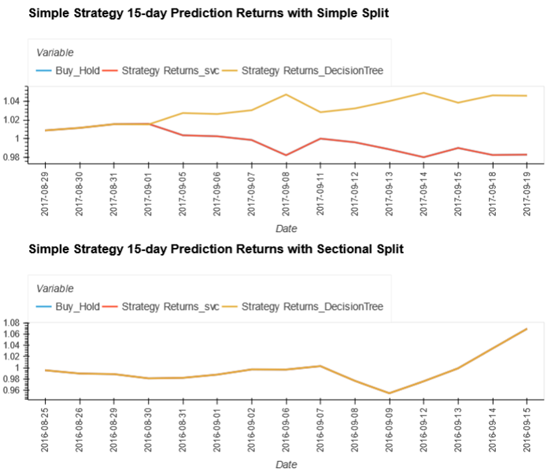
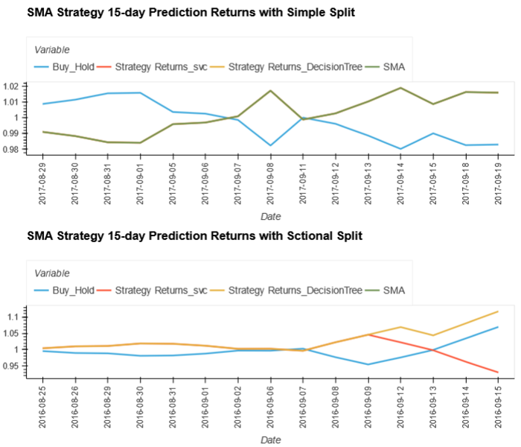
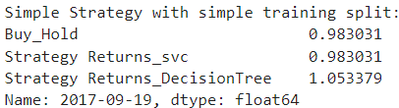
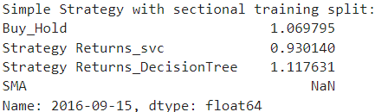
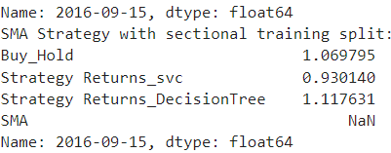
SVC and Decision Tree Trading Signal Predictors (APPL)

Slide 25
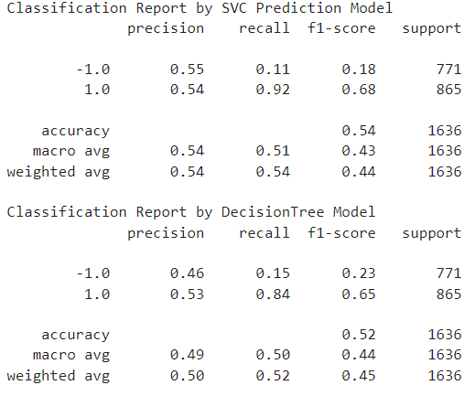
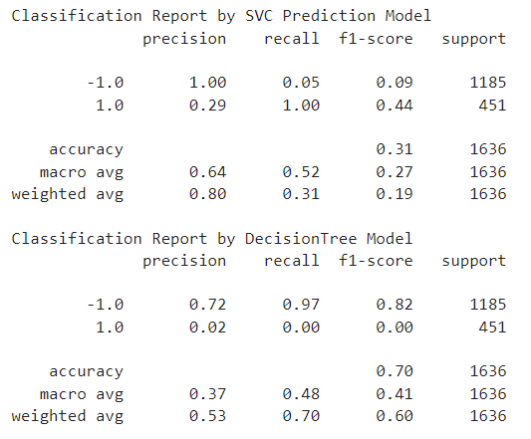
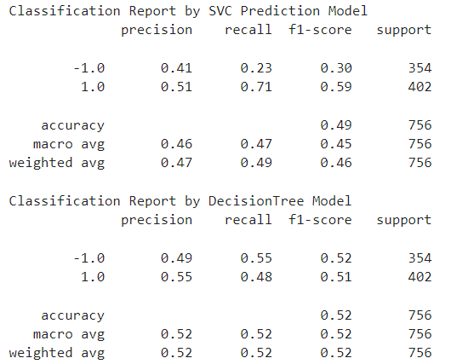
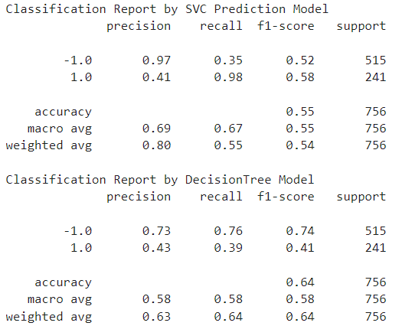
Classification Reports for AAPL
Simple Strategy for AAPL SMA Strategy for AAPL
Simple Split
Sectional Split
Notes:
Classification Reports for S&P

Slide 26
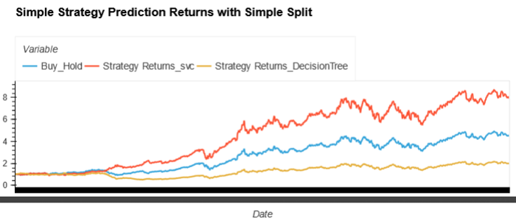
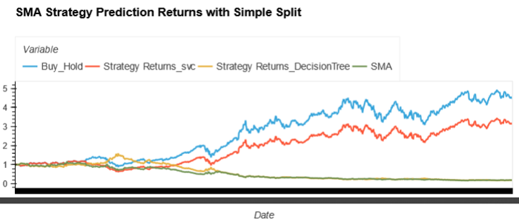
SVC and Decision Tree Trading Signal Predictors (AAPL)

Slide 27
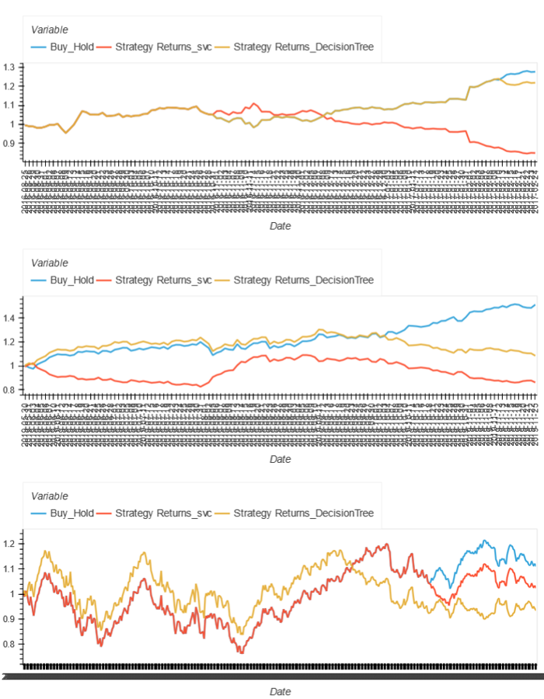
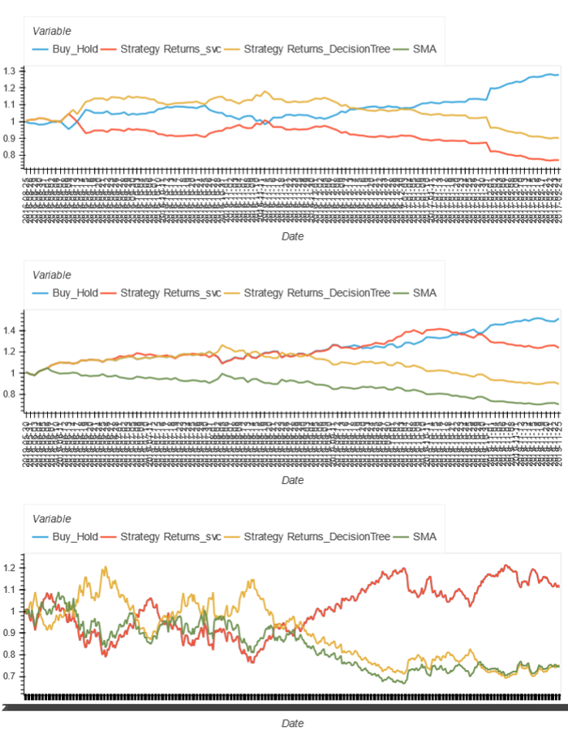
SVC and Decision Tree Trading Signal Predictors (Sectional Split)

Slide 28
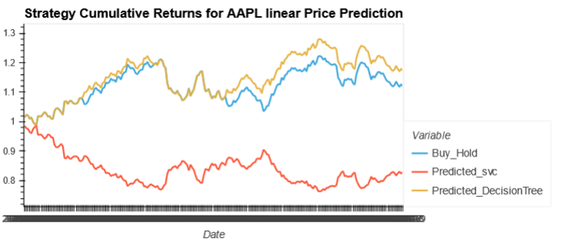
SVC and Decision Tree Trading Signal Predictors with Linear Model Price Prediction

Slide 29
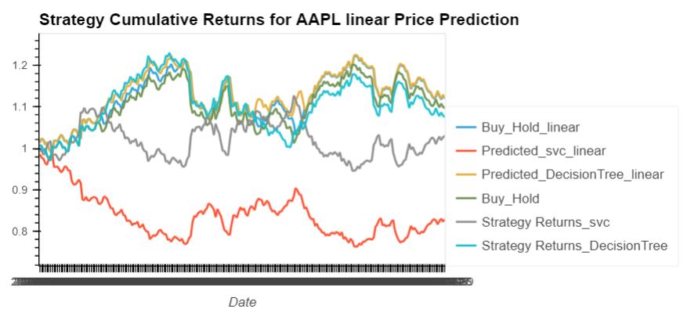
SVC and Decision Tree Trading Signal Predictors with Linear Model Price Prediction
（BayesianRidge）
）

Slide 30
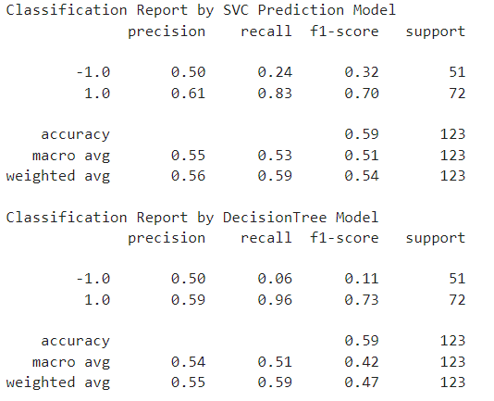
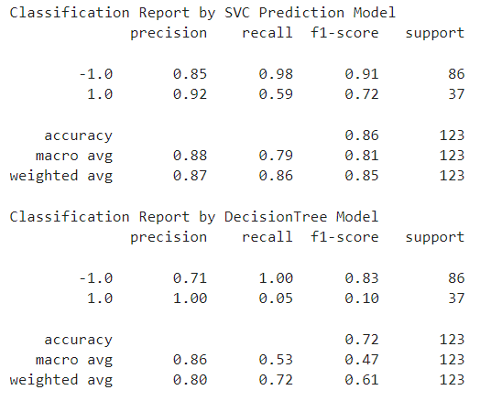
Classification Reports for S&P500
Simple Strategy for S&P500 SMA Strategy for S&P500

Slide 31
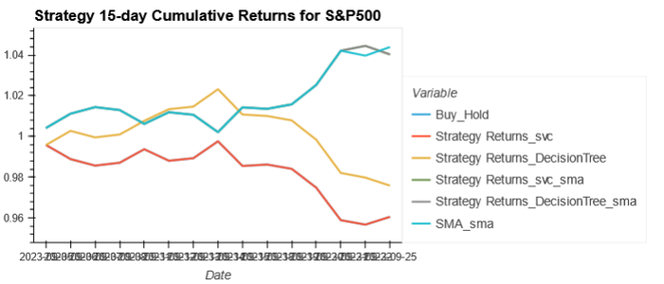
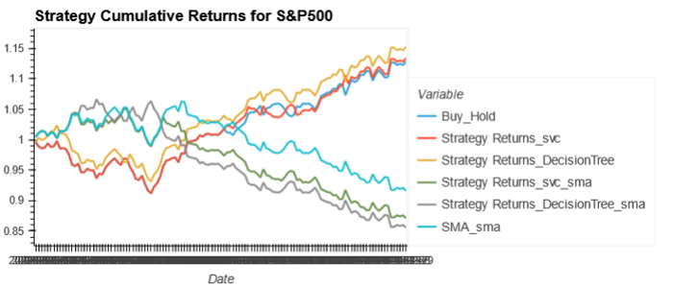
SVC and Decision Tree Trading Signal Predictors S&P500
Buy/Sell(1/-1) Transaction Times:
Actual_signal
0.0 63
1.0 30
-1.0 29
Name: count, dtype: int64
Predicted_svc
0.0 114
-1.0 4
1.0 4
Name: count, dtype: int64
Predicted_DecisionTree
0.0 112
-1.0 5
1.0 5
Name: count, dtype: int64
SVC Prediction Win times ratio is 0.59 with win cumreturn of 1.52 and loss cumulative loss of -0.25
Decision Tree Prediction Win times ratio is 0.63 with wining cum return of 1.60 and loss cumulative loss of -0.22
Buy/Sell(1/-1) Transaction Times:
Actual_signal
0.0 63
1.0 30
-1.0 29
Name: count, dtype: int64
Predicted_svc
0.0 114
-1.0 4
1.0 4
Name: count, dtype: int64
Predicted_DecisionTree
0.0 112
-1.0 5
1.0 5
Name: count, dtype: int64
SVC Prediction Win times ratio is 0.59 with win cumreturn of 1.52 and loss cumretur of -0.25
Decision Tree Prediction Win times ratio is 0.63 with wining cum return of 1.60 and loss cumretur of -0.22

Slide 32
Conclusions and Predictions
Prophet Model:
Facebook Prophet is a valuable tool for time series forecasting, offering a combination of simplicity, flexibility, and accuracy. Its ability to automatically handle seasonality, uncertainty estimation, and incorporation of external factors makes it a popular choice for businesses and researchers across different domains. However, users should still exercise caution and domain-specific knowledge when interpreting the forecasts generated by Prophet, as with any forecasting tool.
Neural Network and LSTM Price Predictor :
Standard scaler works much better than MinMax scaler
Standardize target for LSTM, for NN not necessary
Re-scaling to improve loss didn’t work
Even after plateau, further learning seemed to help
Linear & Regressor Models:
The output in terms of RMSE & MAPE for the best models selected varied with stocks chosen, we believe within a certain range of 2.5% MAPE we can predict the next 14 Day stock prices barring extreme tail events.
SVC and Decision Tree Trading Signal Predictor:
SMA double window crossover strategy performance is not always good for different stocks. Sometimes, simple strategy’s performance is better with certain prediction models for some stocks, such as our testing stocks.
Decision Tree prediction model for effective trading signal predictions performs a bit better in some cases, the model prediction’s performance shows a stock price sliding prevention capability
However, SVC seems has better prediction capability in continuous growing trends.

Slide 33
Implications of Findings
From the exploration of various model’s performance for price prediction and trading signal prediction, we have find the machine learning technical is predicting the future price, price movement as well as trading signals well in certain conditions and environment.
It is obvious that not only one machine learning models fit for the stock trading signals prediction best all the time. Most of the case, only some of the models’ results can be useful to predict the profitable trading signals in certain time.
More testing and trainings as well as model validation and improvements need to be done if we want to lower the risk of using autotrade bots for generating trading profits.

